Slide 1


Santiago Jimenez
07/03/2022

Slide 2

Outline
Executive Summary
Introduction
Methodology
Results
Conclusion
Appendix

Slide 3
Executive Summary
Summary of methodologies
Data Collection through API
Data Collection with Web Scraping
Data Wrangling
Exploratory Data Analysis with SQL
Exploratory Data Analysis with Data Visualization
Interactive Visual Analytics with Folium
Machine Learning Evaluation
Summary of all results
Exploratory Data Analysis results
Interactive analytics in screenshots
Predictive Analytics result

Slide 4
Introduction
Project background and context
Space X advertises Falcon 9 rocket launches on its website with a cost of 62 million dollars; other providers cost upward of 165 million dollars each, much of the savings is because Space X can reuse the first stage. Therefore, if we can determine if the first stage will land, we can determine the cost of a launch. This information can be used if an alternate company wants to bid against space X for a rocket launch. This goal of the project is to create a machine approach to predict if the first stage will land successfully.
Problems you want to find answers
What factors determine if the rocket will land successfully?
The interaction amongst various features that determine the success rate of a successful landing.
What operating conditions needs to be in place to ensure a successful landing program.

Slide 5

Section 1

Slide 6
Methodology
Executive Summary
Data collection methodology:
Data was collected using SpaceX API and web scraping from Wikipedia and other sources related.
Perform data wrangling
One-hot encoding, dropping rows with (NaN), replace values, renown columns.
Perform exploratory data analysis (EDA) using visualization and SQL
Perform interactive visual analytics using Folium and Plotly Dash
Perform predictive analysis using classification models
How to build, tune, evaluate classification models

Slide 7

Data Collection – SpaceX API
Data collection was done using get request to the SpaceX API.
We collected, decoded, cleaned and scrapping data from Wikipedia and other sources.
The link to the notebook is https://github.com/santiagojz001/Data_Science_Capstone/blob/master/Data%20Collection.ipynb
Place your flowchart of SpaceX API calls here

Slide 8

Data Collection - Scraping
We applied web scrapping to the Falcon 9 launch records with BeautifulSoup, parsed and transformed the data to a DataFrame.
The GitHub URL of the completed web scraping notebook, https://github.com/santiagojz001/Data_Science_Capstone/blob/master/Data%20Collection%20with%20Web%20Scraping.ipynb
Place your flowchart of web scraping here

Slide 9
Data Wrangling
In this stage we perform some Exploratory Data Analysis (EDA) to find some patterns in the data and determine what would be the label for training supervised models.
We calculated the number of launches at each site, and the number and occurrence of each orbits
We created landing outcome label from outcome column and exported the results to csv.
The GitHub URL of the completed data wrangling https://github.com/santiagojz001/Data_Science_Capstone/blob/master/EDA%20Exploratory%20Data%20Analysis.ipynb

Slide 10
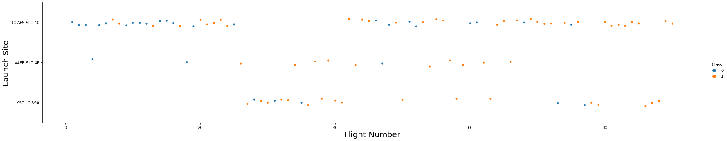
EDA with Data Visualization
Perform Exploratory Data Analysis Using the libraries Pandas and Matplotlib.
We used the different plots, to see the relations and correlations in data, through Line plots, Scatterplots, etc.
The GitHub URL of the completed EDA with data visualization https://github.com/santiagojz001/Data_Science_Capstone/blob/master/EDA%20with%20Visualization.ipynb

Slide 11
EDA with SQL
We analyzed the data available as a .CSV (comma separated values) format, store and load the data into IBM DB2 Platform.
We applied EDA with SQL to get insight from the data. We wrote queries to find out as an example:
The names of unique launch sites in the space mission.
The total payload mass carried by boosters launched by NASA (CRS)
The average payload mass carried by booster version F9 v1.1
The total number of successful and failure mission outcomes
Etc.
The link to the notebook https://github.com/santiagojz001/Data_Science_Capstone/blob/master/EDA%20with%20SQL.ipynb
Add the GitHub URL of your completed EDA with SQL notebook, as an external reference and peer-review purpose

Slide 12
Build an Interactive Map with Folium
We marked all launch sites, and added map objects such as markers, circles, lines to mark the success or failure of launches for each site on the folium map.
We calculated the distances between a launch site to its proximities. We answered some question for instance:
Are launch sites near railways, highways and coastlines.
Do launch sites keep certain distance away from cities.
We assigned the feature launch outcomes (failure or success) to class 0 and 1.i.e., 0 for failure, and 1 for success.
Using the color-labeled marker clusters, we identified which launch sites have relatively high success rate.

Slide 13
Build a Dashboard with Plotly Dash
We built an interactive dashboard with Plotly dash
We plotted pie charts showing the total launches by a certain sites
We plotted scatter graph showing the relationship with Outcome and Payload Mass (Kg) for the different booster version.
The GitHub URL of the completed Plotly Dash lab, as an external reference is:
https://github.com/santiagojz001/Data_Science_Capstone/blob/master/dash.py

Slide 14
Predictive Analysis (Classification)
We loaded the data using Numpy and Pandas, transformed the data, split our data into training and testing.
We built different machine learning models and tune different hyperparameters using GridSearchCV.
We used accuracy as the metric for our model, improved the model using feature engineering and algorithm tuning.
We found the best performing classification model.
The GitHub URL of your completed predictive analysis lab, as an external reference is: https://github.com/santiagojz001/Data_Science_Capstone/blob/master/Machine%20Learning%20Prediction.ipynb

Slide 15
Results
Exploratory data analysis results
Interactive analytics demo in screenshots
Predictive analysis results

Slide 16

Section 2

Slide 17

Flight Number vs. Launch Site
Show that the larger the flight amount at a launch site, the greater the success rate at a launch site.

Slide 18
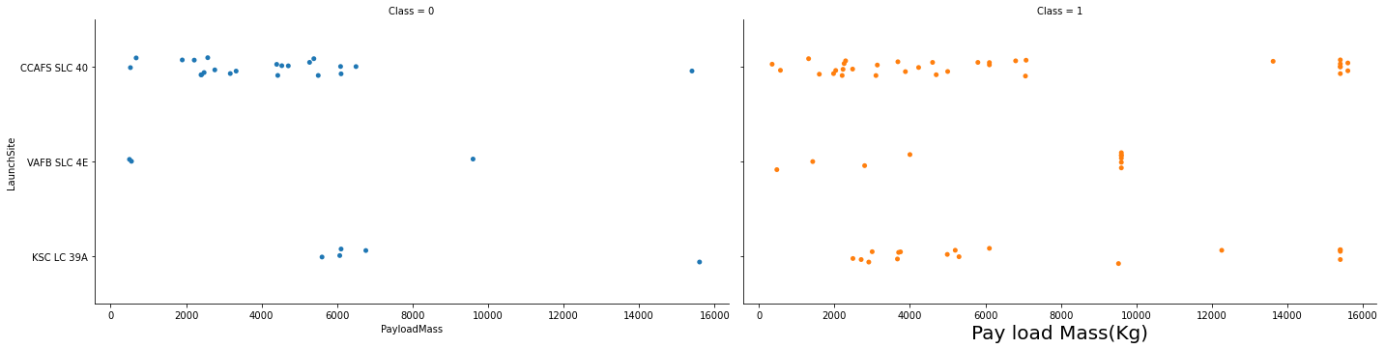
Payload vs. Launch Site
Show that for the VAFB-SLC launch site there are no rockets launched for heavypayload mass(greater than 10000).

Slide 19
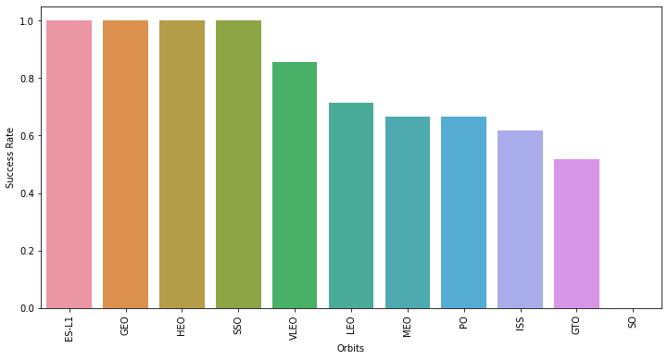
Success Rate vs. Orbit Type
The plot shows that ES-L1, GEO, HEO, SSO, VLEO values had the most success rate.

Slide 20
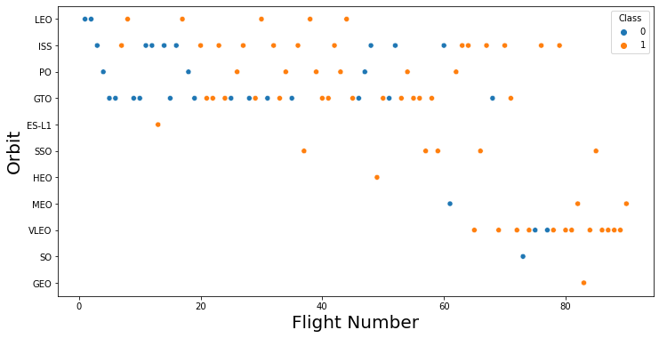
Flight Number vs. Orbit Type
The plot shows that in the LEO orbit the Success appears related to the number of flights; on the other hand, there seems to be no relationship between flight number when in GTO orbit.

Slide 21
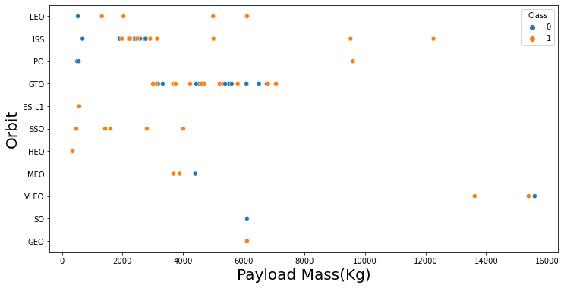
Payload vs. Orbit Type
The plot shows that with heavy payloads the successful landing or positive landing rate are more for Polar, LEO and ISS.
However for GTO we cannot distinguish this well as both positive landing rate and negative landing(unsuccessful mission) are both there here.

Slide 22
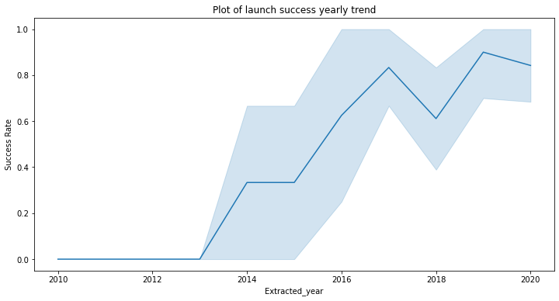
Launch Success Yearly Trend
The plot shows that the success rate since 2013 kept increasing till 2020

Slide 23
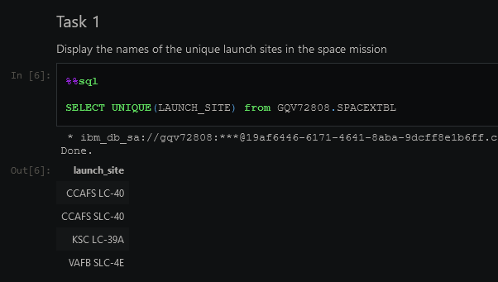
All Launch Site Names
We used the key word (UNIQUE) of SQL to show only unique launch sites from the SpaceX Data.

Slide 24
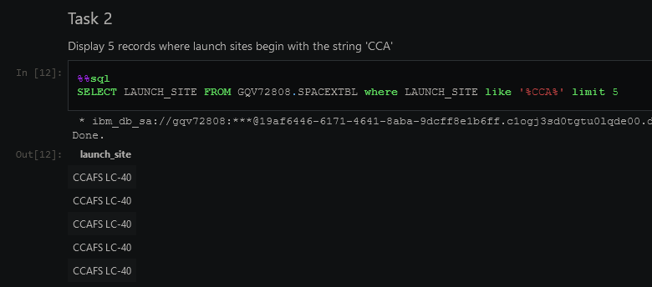
Launch Site Names Begin with 'CCA'
We used the query (LIMIT & LIKE) to display 5 records where launch sites begin with ‘CCA’

Slide 25
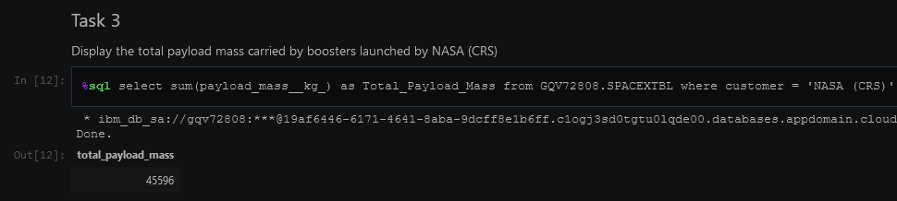
Total Payload Mass
The total payload value carried by boosters from NASA was 45596 and query using the key words WHERE & AS

Slide 26
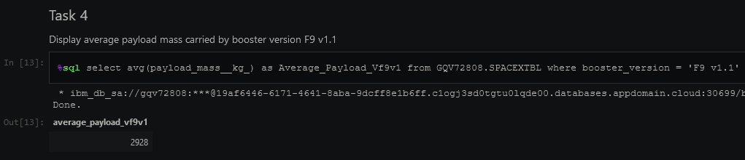
Average Payload Mass by F9 v1.1
The Average Payload Mass was 2928

Slide 27
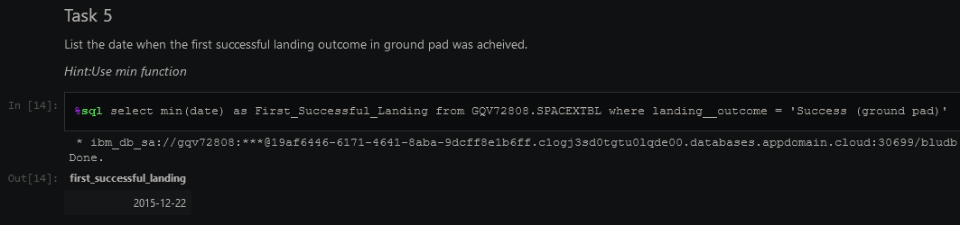
First Successful Ground Landing Date
We can see that the dates of the first successful landing outcome on ground pad was 22nd December 2015

Slide 28
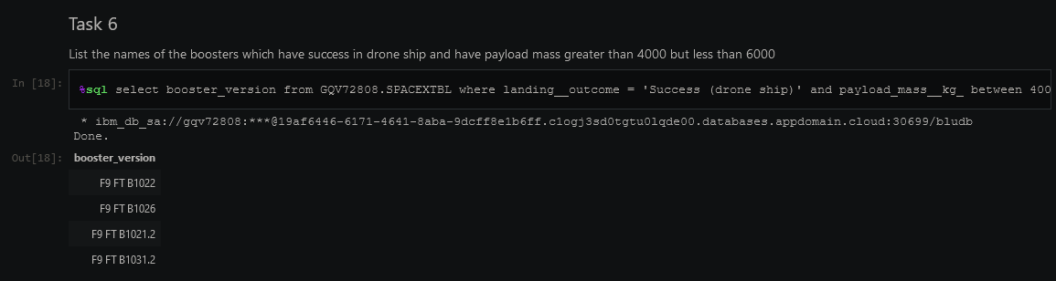
Successful Drone Ship Landing with Payload between 4000 and 6000
The names of boosters which have successfully landed on drone ship and had payload mass greater than 4000 but less than 6000 were query using the keywords WHERE and BETWEEN:

Slide 29
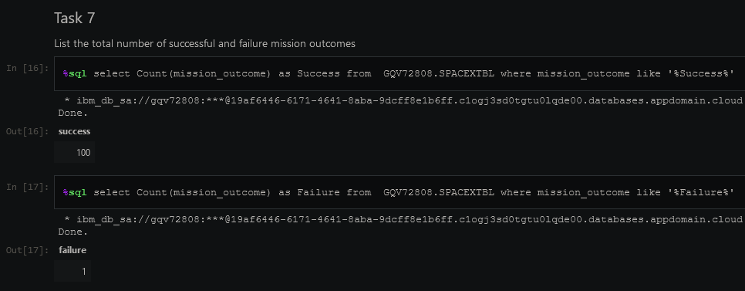
Total Number of Successful and Failure Mission Outcomes
The total number of successful and failure mission outcomes are 100 and 1 in that order:

Slide 30
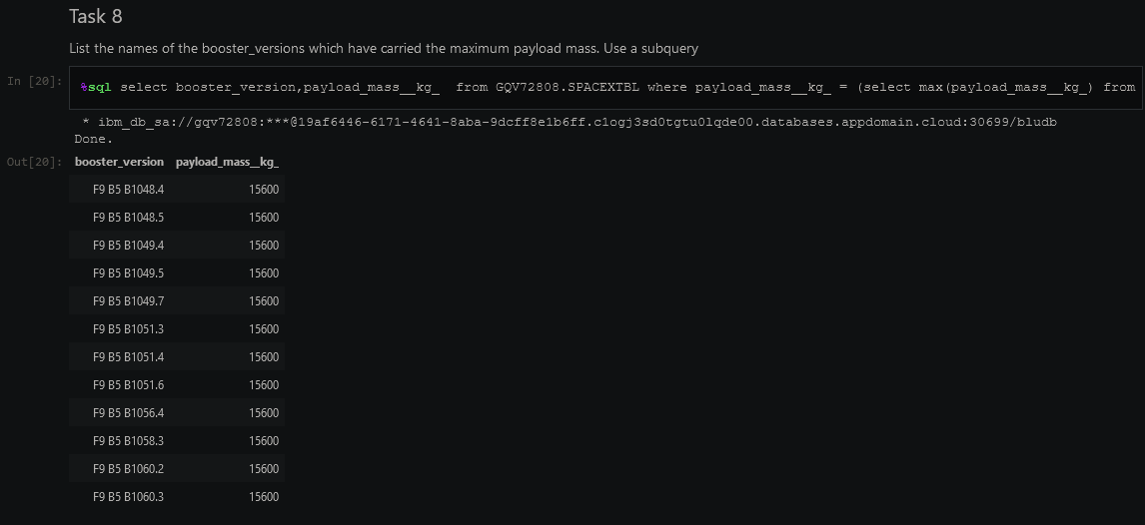
Boosters Carried Maximum Payload
The names of the booster which have carried the maximum payload mass were calculated using a subquery in the WHERE clause and the MAX() function.

Slide 31
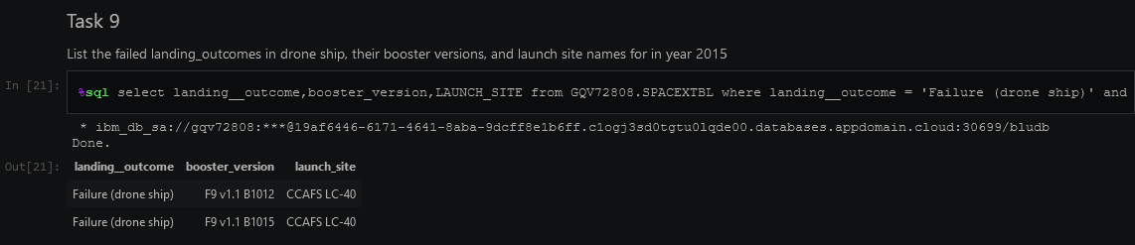
2015 Launch Records
The failed landing outcomes in drone ship, their booster versions, and launch site names for in year 2015 are:

Slide 32
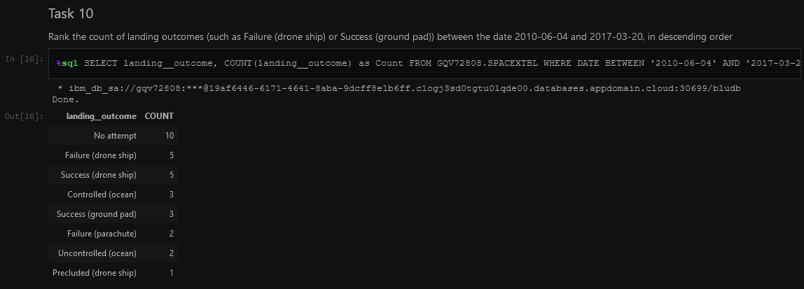
Rank Landing Outcomes Between 2010-06-04 and 2017-03-20
The count of landing outcomes (such as Failure (drone ship) or Success (ground pad)) between the date 2010-06-04 and 2017-03-20, in descending order are:

Slide 33

Section 3

Slide 34
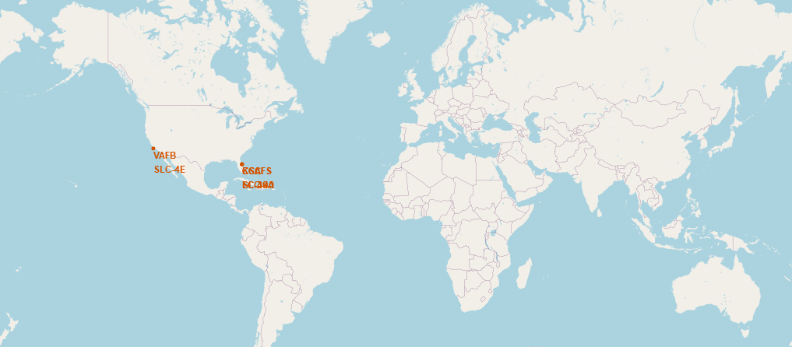
Launch sites SpaceX
The SpaceX launch sites are located in the coast areas of USA (Florida & California)

Slide 35
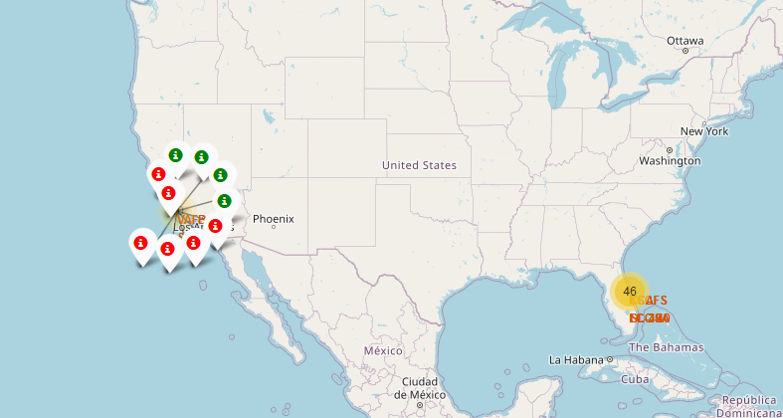
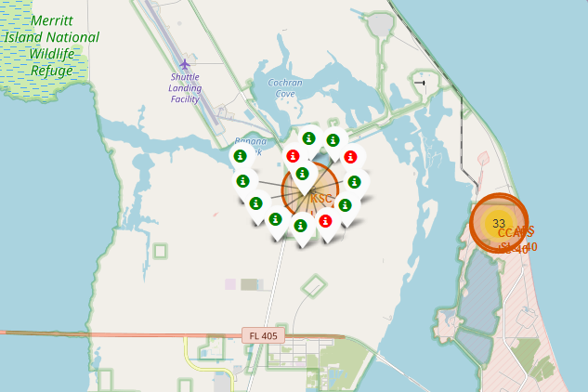
Markers with color labels, showing Launch sites
Green markers show successful Launches, Red markers show failures.
Florida Launch Sites
California Launch Site

Slide 36

Launch sites distances to Landmarks

Slide 37

Section 4

Slide 38

Pie chart of the success percentage reached by each launch site

Slide 39

Pie chart of the Launch site with the highest launch success ratio

Slide 40

Scatter plot of Payload vs Launch Outcome for all sites, with different payload selected in the range slider

Slide 41

Section 5

Slide 42
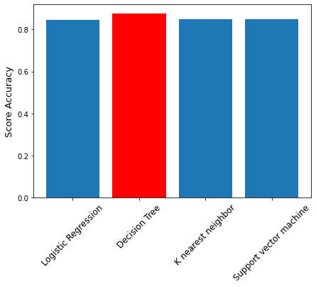
Classification Accuracy
All methods display a similar value of accuracy, but the Decision Tree Classifier with the value of 0.88 represents the most optimal model.

Slide 43
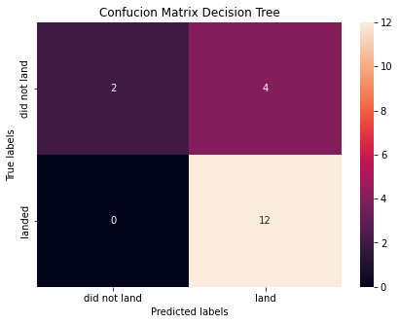
Confusion Matrix
The confusion matrix for the decision tree classifier shows that the classifier can distinguish between the different classes.
Conversely, the major problem is the false positives .i.e., unsuccessful landing marked as successful landing by the classifier.

Slide 44
Conclusions
Analyzing the data so far, we can conclude that:
The larger the flight amount at a launch site, the greater the success rate at a launch site.
Launch success rate started to increase in 2013 till 2020.
Orbits ES-L1, GEO, HEO, SSO, VLEO had the most success rate.
KSC LC-39A had the most successful launches of any sites.
The Decision tree classifier is the best machine learning algorithm for this task.

Slide 45
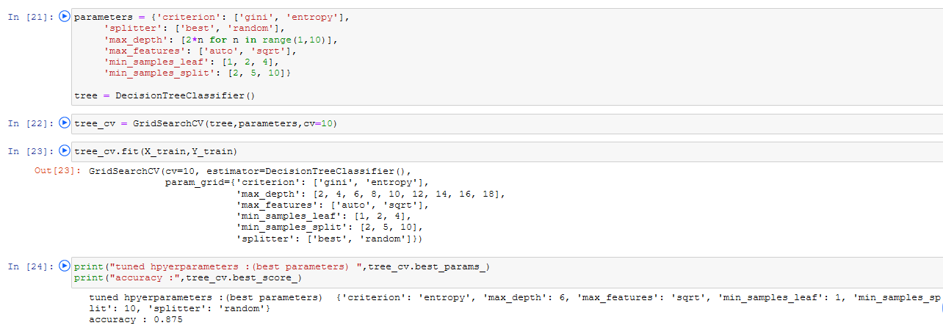
Appendix
Finding the best parameters for the model

Slide 46


